Slide 1
Ranking support for keyword search on structured data using relevance model
Date: 2012/06/04
Source: Veli Bicer(CIKM’11)
Speaker: Er-gang Liu
Advisor: Dr. Jia-ling Koh

Slide 2
Outline
Introduction
Relevance Model
Edge-Specific Relevance Model
Edge-Specific Resource Model
Smoothing
Ranking
Experiment
Conclusion

Slide 3
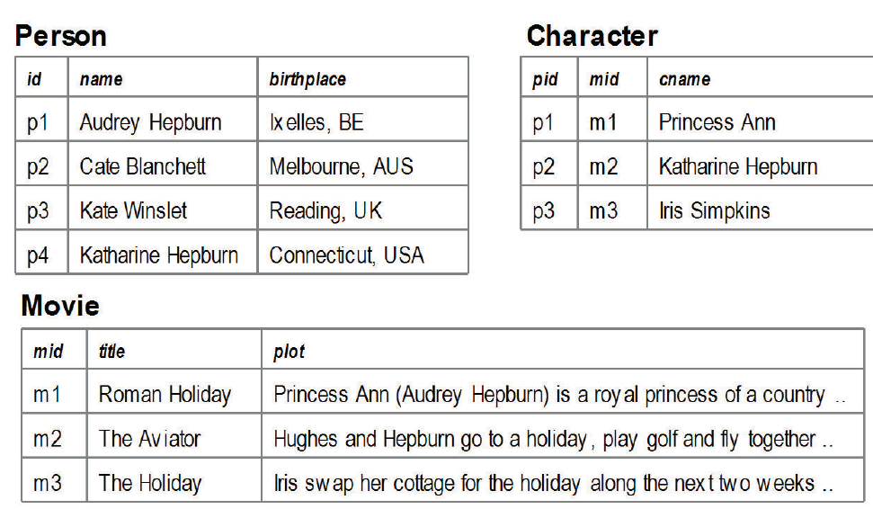
Introduction - Motivation
Keyword Search
Q={Hepburn, Holiday},
Result = { p1, p4, p2m2, m1, m2, m3 }
Not Good
SQL
SELECT cname
FROM Person, Character, Movie
WHERE Person.id = Character.pid
AND Character.mid = Movie.id
AND Person.name = ‘Hepburn'
AND Movie.title = ‘Holiday'
Difficult

Slide 4
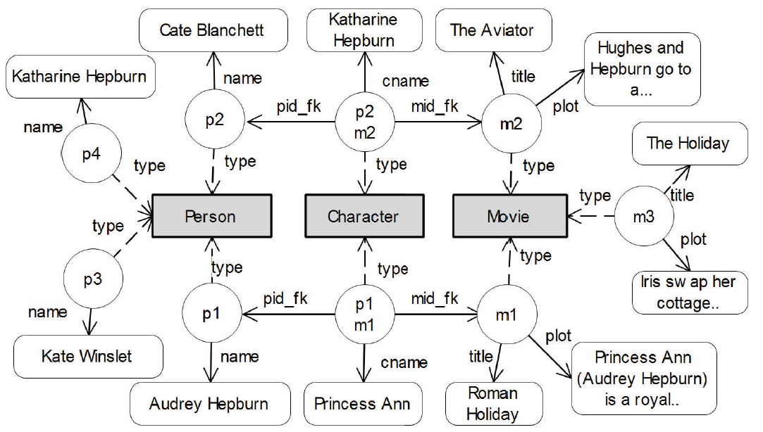
Introduction - Goal
1
Keyword search
Q={Hepburn, Holiday}
Result =
{ p1, p4, p2m2, m1, m2, m3}
2
Keyword
index

Slide 5
Introduction - Goal
Result
3
Top K
Relevance
Title | Name
Roman Holiday | Audrey Hepburn
Breakfast at Tiff. | Audrey Hepburn
The Aviator | Katharine Hepbun
The Holiday | Kate Winslet
Ranking
Score & Schema

Slide 6
Introduction- overview
1
Query
2
PRF
3
Query RM
4
Resource RM
words | p
hepburn | 0.21
holiday | 0.15
audrey | 0.13
katharine | 0.09
princess | 0.01
roman | 0.01
…. | …
words | p
hepburn | 0.12
holiday | 0.18
audrey | 0.11
katharine | 0.05
princess | 0.00
roman | 0.06
…. | …
words | p
hepburn | 0.5
holiday | 0.5
Resource
Score
Result Ranking
5
6
H(RM_{Q}||RM_{R})
Title | Name
Roman Holiday | Audrey Hepburn
Breakfast at Tiff. | Audrey Hepburn
The Aviator | Katharine Hepbun
The Holiday | Kate Winslet

Slide 7
Resource nodes (tuple) (p1,p2,m1…) is typed (attribute names)
Resources have unique ids, (primary keys)
Attribute nodes (Attribute value, ex: “Audrey Hepburn”)

Slide 8
Relevance
Model
Ranking
Methods
Smoothing
Edge-Specific Relevance
Edge-Specific Resource
Smoothing
Ranking JRTs

Slide 9
Relevance Models
Q={Hepburn, Holiday}
Document Model
Query Model
Resource
Score
Similarity
Measure
H(RM_{Q}||D₁)
H(RM_{Q}||D₂)
H(RM_{Q}||D₃)
.
.

Slide 10
Relevance Models
Q={Hepburn, Holiday}
Document Model
Query Model
Resource
Score
Similarity
Measure
name
H(RM_{Q}||D₁-A_{title})
title
birthplace
H(RM_{Q}||D₁-A_{plot})
plot
.
.
.

Slide 11
Edge-Specific Relevance Models
A set of feedback resources F_{R} are retrieved from an inverted keyword index:
Edge-specific relevance model for each unique edge e:
Probability of word in attribute
Importance of data for query
Q = { Hepburn, Holiday } , F_{R} = { p₁, p₄, m_{1 ,} m₂ , m_{3,} , p₂m₂ }
Inverted Index
F_{R}
princess → m₁ , p₁ m₁
breakfast → m₃
hepburn → p₁ , p₄ , m₁, p₂m₂
melbourne → m₁
holiday → m₁ , m₂ , m₃
ann → m₁
P_{p1 → a} (audrey | a) = $\frac{1}{2}$
p₁
p₁
name
name
birthplace
name
P_{p1 → a} (hepbum | a) = $\frac{1}{2}$
Audrey Hepburn
Ixelles Belgium
Audrey Hepburn
name
m₃
title
The Holiday
m₃
P_{m3 → a} (holiday | a) = $\frac{1}{11}$
plot
plot
plot
Iris swaps her cottage for the holiday along the next two
Iris swaps her cottage for the holiday along the next two
…..

Slide 12
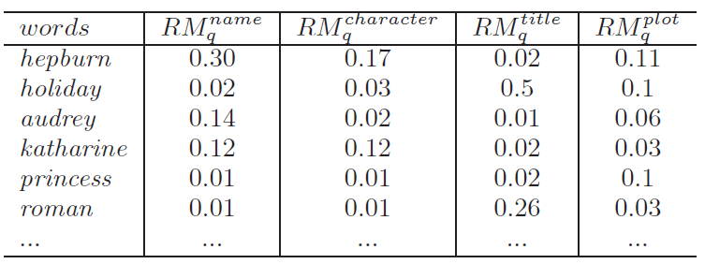
Edge-Specific Relevance Models
Importance of data for query
Edge-specific Relevance Models
P (name | p1) = $\frac{2}{2+2}$
p₁
name
birthplace
Audrey Hepburn
Ixelles Belgium
P (plot | m3) = $\frac{11}{11+2}$
m₃
title
The Holiday
P_{p1 → a} (hepbum | a) (name | p1)
= $\frac{1}{4}∗\frac{2}{4}$
name
plot
Iris swaps her cottage for the holiday along the next two
…..
P_{m3 → a} (holiday | a) (plot | m3)
= $\frac{1}{11}∗\frac{11}{13}$
plot

Slide 13
Edge Specific Resource Models
Each resource (a tuple) is also represented as a RM
final results (joint tuples) are obtained by combining resources
Edge-specific resource model:
terms of the attribute
terms in all attributes
v = Hepburn
P_{p1 → a}
P_{p1 → a}
name
*
P_{p1 → a} (Hepburn | a) = $\frac{1}{2}$
P_{p1 → a} (hepbum | a) (name | p1)
= $\frac{1}{4}∗\frac{2}{4}$
p₁
name
p₁
name
name
birthplace
Audrey Hepburn
Audrey Hepburn
Ixelles Belgium

Slide 14
Resource Score
The score of resource: cross-entropy of edge-specific RM and Resource RM:
Query RM
Resource RM
words | p
hepburn | 0.21
holiday | 0.15
audrey | 0.13
katharine | 0.09
princess | 0.01
roman | 0.01
…. | …
words | p
hepburn | 0.12
holiday | 0.18
audrey | 0.11
katharine | 0.05
princess | 0.00
roman | 0.06
…. | …

Slide 15
Relevance
Model
Ranking
Methods
Smoothing
Edge-Specific Relevance
Edge-Specific Resource
Smoothing
Ranking JRTs

Slide 16
Smoothing
Well-known technique to address data sparseness and improve accuracy of Relevance Model
is the core probability for both query and resource RM
Neighborhood of attribute a is another attribute a’:
Person
Character
type
type
type
p₁
pid_fk
c₁
p₄
name
birthplace
name
name
Audrey Hepburn
Ixelles Belgium
Princess Ann
Katharine Hepburn
birthplace
Connecticut USA
a and a’ shares the same resources
resources of a and a’ are of the same type
resources of a and a’ are connected over a FK

Slide 17
Smoothing
Smoothing of each type is controlled by weights:
where γ₁ ,γ₂ ,γ₃ are control parameters set in experiments
is sigmoid function.
is the cosine similarity

Slide 18
Relevance
Model
Ranking
Methods
Smoothing
Edge-Specific Relevance
Edge-Specific Resource
Smoothing
Ranking JRTs

Slide 19
Ranking JRTs
Ranking aggregated JRTs:
Cross entropy between edge-specific RM (Query Model) and geometric mean of combined edge-specific Resource Model:
Title | Plot
Roman Holiday | Iris swqp her collage for the holiday…….
Name | Birthplace
Audrey Hepburn | Lx elles, BE
Cname
Princess Ann

Slide 20
Ranking JRTs
The proposed score is monotonic w.r.t. individual resource scores

Slide 21
Experiments
Datasets:
Subsets of Wikipedia, IMDB and Mondial Web databases
Queries:
50 queries for each dataset including “TREC style” queries and “single resource” queries
Metrics:
The number of top-1 relevant results
Reciprocal rank
Mean Average Precision (MAP)
Baselines:
BANKS
Bidirectional (proximity)
Efficient
SPARK
CoveredDensity (TF-IDF)
RM-S: Paper approach

Slide 22
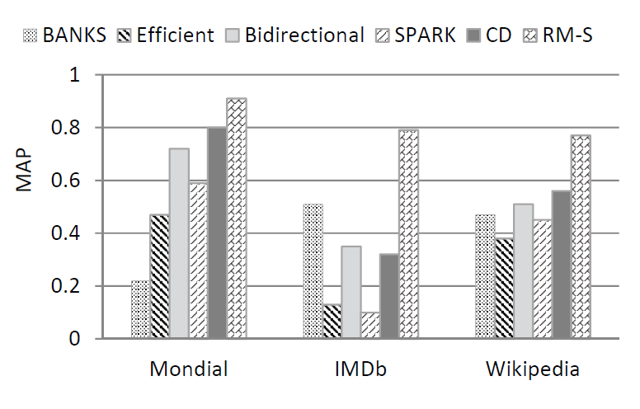
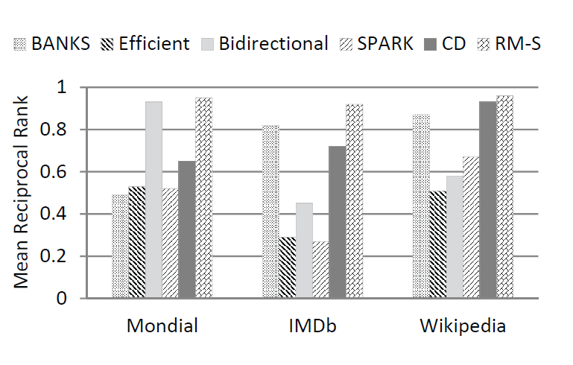
Experiments
MAP scores for all queries
Reciprocal rank for single resource queries

Slide 23
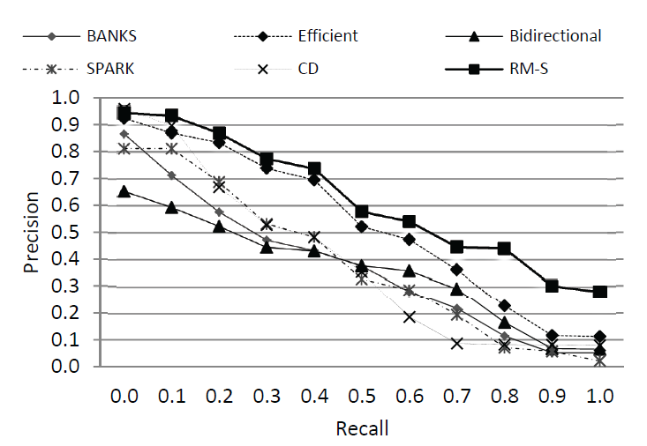
Precision-recall for TREC-style queries on Wikipedia

Slide 24
Conclusions
Keyword search on structured data is a popular problem for which various solutions exist.
We focus on the aspect of result ranking, providing a principled approach that employs relevance models.
Experiments show that RMs are promising for searching structured data.

Slide 25
MAP(Mean Average Precision)
Topic 1 : There are 4 relative document ‧ rank : 1, 2, 4, 7
Topic 2 : There are 5 relative document ‧ rank : 1, 3 ,5 ,7 ,10
Topic 1 Average Precision : (1/1+2/2+3/4+4/7)/4=0.83。
Topic 2 Average Precision : (1/1+2/3+3/5+4/7+5/10)/5=0.45。
MAP= (0.83+0.45)/2=0.64。
Reciprocal Rank
Topic 1 Reciprocal Rank : (1+1/2+1/4+1/7)/4=0.473。
Topic 2 Reciprocal Rank : (1+1/3+1/5+1/7+1/10)/5=0.354。
MRR= (0.473+0.354)/2=0.4135。

